Slide 1
SD: Patterns .NET
31-Mar-18 | Start
Appendix
Online

Slide 2
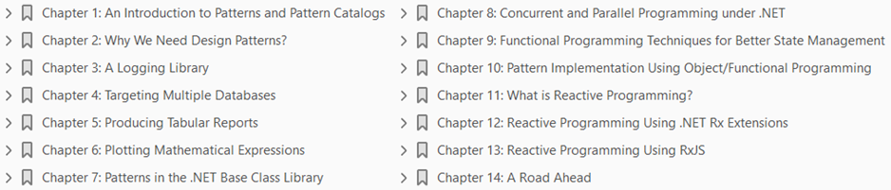
Design Patterns
Ch | Date
1 | ddmmmyy
2
3
4
5
6
7
8
.NET Design Patterns 01 2017

Slide 3
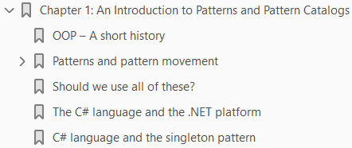
An Introduction to Patterns and Pattern Catalogs
1

Slide 4
Intro
Design patterns have always fascinated software developers, yet true knowledge of their applicability and consequences has eluded many.
The various solutions that have been created and applied to solve similar problems have been studied over time by experienced developers and architects.
A movement slowly began to catalog such time-tested and successful solutions, which served as a blueprint for software design.
The applicability of design patterns exhibited maturity (even though over-engineering was a perceived risk) in solution architecture (in terms of stability, consistency, maintainability, and extensibility), and became a core skill for serious developers and architects.
In this introduction to patterns and pattern catalogs, the authors wish to provide a detailed illustration of the movement in the software development industry that led to the discovery and consolidation of the various patterns and pattern catalogs.
It is equally important to understand the evolution of patterns, idioms, programming languages, and standards that led to standardization of these technology-agnostic blueprints, which form the basis of enterprise application development today.

Slide 5
Topics
We will cover the following topics in this regard:
History of object-oriented programming (OOP) techniques, idioms, and patterns
Patterns and pattern movement
Key patterns and pattern catalogs
Key C# language features that facilitate implementation of OOP techniques, idioms, and patterns

Slide 6
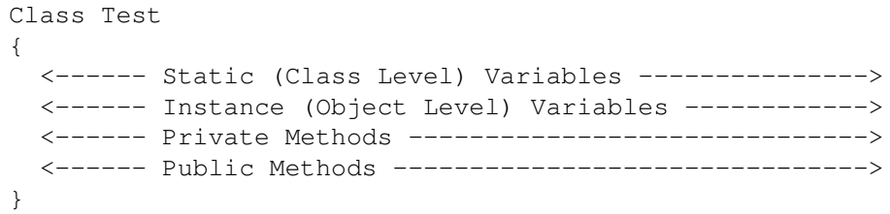
OOP – A short history
OOP is a programming model that is supposed to combine structure (data) and behavior (methods) to deliver software functionality.
This was a marked contrast from the procedural programming model, which was mostly in vogue when the OOP model gained prominence.
The primary unit of composition in a procedural programming model is a procedure (mostly a function with side-effects).
Data is fed into a series of procedures that constitutes the process or algorithm in a solution context.
In the case of OOP, the data and related functions are represented together as a class, which acts as a fundamental unit in the programming model.
Schematically it is as follows:

Slide 7
OOP Revolution
As a programmer, one can create many instances of a class during the execution of a program.
Since class encapsulates data and its associated operations to provide a coherent entity, the problems (or rather side-effects) associated with global variables/data (being used as payload for the procedures) went away all of a sudden.
This helped to manage the complexity of developing large software.
OOP revolutionized the way programmers modeled the problem domain, with class compositions leveraging encapsulation, association, inheritance, and polymorphism.
Additionally, with the flexibility to model hierarchies (that closely represent the problem domain) with ease, it became natural for developers to think in terms of objects.

Slide 8
OOP Origin
The origin of OOP can be traced back to the Simula programming language created by Kristen Nygaard and Ole-Johan Dahl, released in the year 1965.
The advent of the Smalltalk system helped the ideas of OOP to percolate to the academia and some consulting circles.
Smalltalk was a dynamically typed language, and primarily designed as a message passing system.
Later, they added Simula's class-based Object model.
Alan Kay, Dan Inaglis, and Adele Goldberg at Xerox PARC designed the language.

Slide 9
OOP Evolution
The OOP model reached a critical mass in the early 1990s, with the popularity of the C++ programming language.
Even though Smalltalk and C++ were OOP languages, Smalltalk was a dynamically typed programming language, and C++ was a statically typed (though weakly enforced) programming language.
The C++ programming language was created by Bjarne Stroustrup at the AT&T Bell Laboratories, as an extension of C (for wider adoption).
In this regard, C++, as a programming language, has issues in terms of usage because of the compulsion to make it C-compatible.
The story of evolution of the language is well chronicled in, The Design and Evolution of C++, a book written by Bjarne himself.
The book deals with the rationale of designing the language and the design choices available for him to incorporate features such as single inheritance, multiple inheritance, virtual methods, exception handling, templates (Generics), I/O streams, and so on.
Any serious C++ developer should not miss this particular book, as it helps to understand the reason why the C++ programming language is the way it is!

Slide 10
Protocol-based Programming & Java
There were attempts to make protocol-based development using middleware technologies like Microsoft's Component Object Model (COM) and OMG's Common Object Request Broker Architecture (CORBA).
Both CORBA and COM were very similar, and both facilitated object interoperability at the binary level.
Each protocol had its own binary encoding format, and interoperability between these two standards became a problem.
Some enterprising companies made a living by writing COM/CORBA bridge to rectify this problem.
Also, COM was mostly available only on Microsoft Windows, making it a platform-specific solution.
Then, in 1996, Sun Microsystems came up with a language which was marketed as a programming language to write applications that are hosted in a browser (Applets). They named it Java.
However, due to performance and political reasons, applet development did not take off.
The language, along with its associated platform, was soon projected as a server-side programming system.
This was a tremendous success, and the Java language made a strong comeback, further popularizing the OOP programming model.
The primary architect of the Java language was James Gosling.

Slide 11
C#
In the year 2001, Microsoft released C#, a brand new OOP language for their new virtual machine development platform, known as .NET.
Later, Microsoft did add support for generics, lambda, dynamic typing, and LINQ, among others, to make C# one of the most powerful programming languages in the world.
The primary architect of the language was Anders Hejlsberg.
Meanwhile, languages such as Ruby and Python made an appearance, and are still relevant in certain areas.
Then, there were object-functional languages such as F#, Scala, Groovy, Clojure, and so on.
However, the OOP model is symbolized by C++, C#, and Java.

Slide 12
Patterns and pattern movement
Programmers of the early 1990s struggled a lot to understand OOP, and how to effectively use them in large projects.
Without a viral medium such as the Internet, it was quite a struggle for them.
Early adopters published technical reports, wrote in periodicals/journals, and conducted seminars to popularize OOP techniques.
Magazines such as Dr. Dobbs Journal and C++ Report carried columns featuring OOP.
A need was felt to transfer the wisdom of the experts to the ever-increasing programming community, but this knowledge propagation was not happening.
The legendary German mathematician Carl Friedrich Gauss once remarked, “Always learn from the masters”.
Even though Gauss had mathematics in mind, it is true for any non-trivial human endeavor.
However, there were very few masters of the OOP techniques, and the apprenticeship model was not scaling well.

Slide 13
Pattern Movement
James Coplien published an influential book titled Advanced C++ Programming Styles and Idioms, which dealt with low-level patterns (idioms) associated with the usage of the C++ programming language.
Despite being not widely cited, authors consider this a notable book towards cataloguing the best practices and techniques of OOP.
The Figure C-1 illustrates the evolution of design methodologies, programming languages, and pattern catalogs:

Slide 14
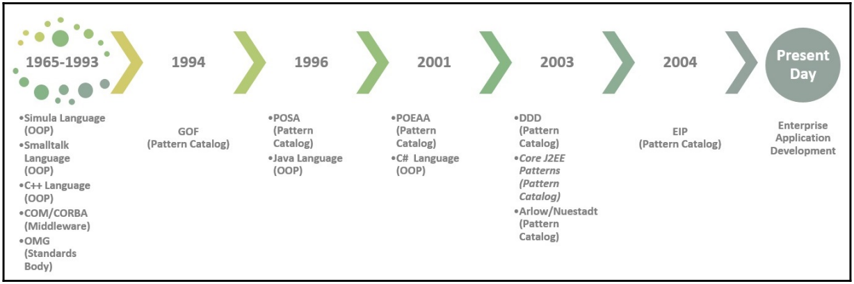
Figure C-1

Slide 15
GoF
It was during this time that Erich Gamma began his work on a pattern catalog as part of his PhD thesis, inspired by an architect named Christopher Alexander.
Christopher Alexander's A Pattern Language – Towns, Buildings, Construction was a source of inspiration for Erich Gamma.
Then, people with similar ideas, namely Ralph Johnson, John Vlissides, and Richard Helm, joined hands with Erich Gamma to create a catalog of 23 patterns, now popularly known as the Gang of Four (GoF) design patterns.
Addison Wesley published the book Design Patterns: Elements of Reusable Object-Oriented Software in the year 1994.
This soon became a great reference for the programmer, and fueled software development based on patterns.
The GoF catalog was mostly focused on software design.

Slide 16
POSA
In the year 1996, a group of engineers from Siemens published a book titled Pattern-Oriented Software Architecture, which focused mostly on the architectural aspects of building a system.
The entire Pattern-Oriented Software Architecture (POSA) pattern catalog was documented in five books published by John Wiley and Sons.
The group was joined by Douglas Schmidt, the creator of the Adaptive Communication Environment (ACE) network programming library and TAO (The ACE ORB).
He later became the chair of Object Management Group (OMG), which develops, adopts, and maintains standards such as CORBA and UML.

Slide 17
PoEAA
Another influential catalog was published by Martin Fowler in a book titled Patterns of Enterprise Application Architecture in the year 2001.
The book mostly focused on patterns that come up while developing enterprise applications using the JEE and .NET frameworks.
Incidentally, most of the code snippets were in Java and C#.

Slide 18
EIP
Gregor Hohpe and Bobby Woolf published a pattern catalog to document the patterns that arise in the enterprise integration scenario.
Their catalog titled Enterprise Integration Patterns, published as part of the Martin Fowler signature book series, is widely recognized as a source of ideas regarding enterprise integration techniques.
The Apache Camel integration library is inspired by this book.

Slide 19
Core J2EE Patterns
Best Practices and Design Strategies (by Deepak Alur et al.), although a platform-specific catalog, is a rich source of ideas regarding the structuring of an enterprise application.
The book includes patterns for presentation, data, and service tiers in web application development.

Slide 20
Domain-Driven Design
Domain-Driven Design, published by Eric Evans in the year 2003, deals with a technique called domain-driven design (DDD).
The book uses GoF and Patterns of Enterprise Application Architecture (POEAA) patterns to put forward a design methodology that focuses on building a persistent ignorant domain model.
The book also introduces some patterns and idioms for structuring domain logic.

Slide 21
Enterprise Patterns and MDA
Jim Arlow and Ila Nuestadt published a book entitled Enterprise Patterns and MDA, which catalogued a set of patterns based on the Jungian Archetypes.
This catalog contains nine top-level archetypes and 168 business archetypes for developing applications.

Slide 22
Key pattern catalogs
Patterns are most often catalogued in some kind of pattern repository.
Some of them are published as books.
The most popular and widely used pattern catalog is GoF, named after the four collaborators that produced them.
They are Eric Gama, Ralph Johnson, John Vlissides, and Richard Helm.

Slide 23
Should we use all of these?
Pattern catalogs are available to deal with various concerns of software development, be it design, architecture, security, data, and so on.
Most applications, or even frameworks, leverage only a fraction of the patterns listed earlier.
Understanding the pattern catalogs and their applicability is a rich source of design ideas for any software developer.
A developer should be careful to avoid the malady of so-called pattern diarrhea.
The Table P-1shows the pattern catalogs and use-case.

Slide 24
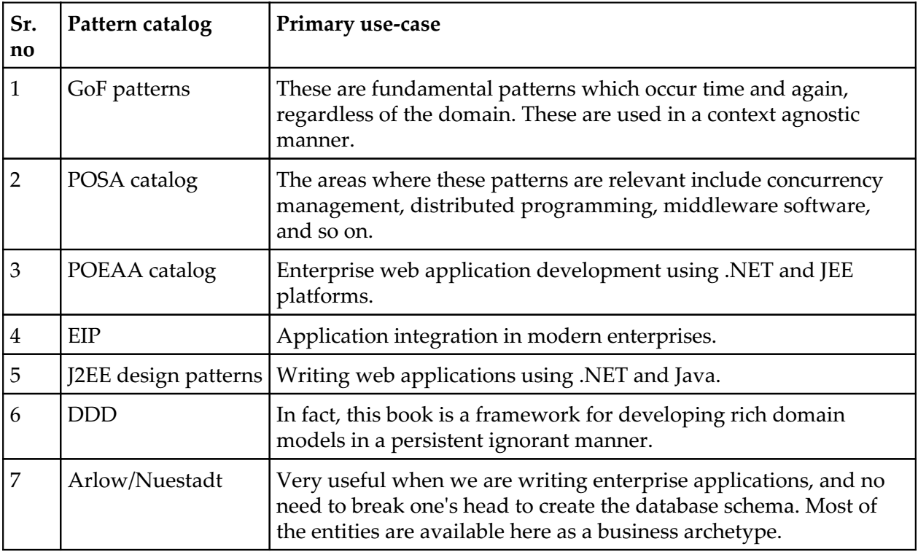
Table P-1

Slide 25
The C# language and the .NET platform

Slide 26
C# language and the singleton pattern
The authors consider the singleton pattern, the way it was presented in the GoF book, as some kind of anti-pattern.
A lot has been written about how to implement it in a multicore/multi-threaded environment.
Constructs such as the double-checked locking pattern have been implemented to incorporate lazy loading while implementing singleton.
The C# programming language has got a nifty feature called a static constructor, which helps to implement the singleton pattern in a thread-safe manner.
The static constructor is guaranteed to be called before any method (including the constructor) is called.
We believe we can stop cutting down trees in order to write about the singleton pattern, at least in the .NET world.

Slide 27
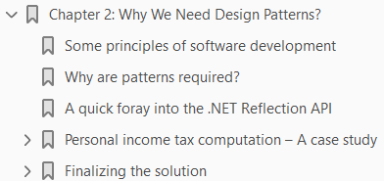
Why We Need Design Patterns?
2

Slide 28
Intro
In this chapter, we will try to understand the necessity of choosing a pattern-based approach to software development.
We start with some principles of software development, that one might find useful while undertaking large projects.
The working example in this chapter starts with a requirements specification and progresses toward a preliminary implementation.
We will then try to iteratively improve the solution using patterns and idioms, and come up with a good design that supports a well-defined programming Interface.
During this process, we will learn about some software development principles that one can adhere to, including the following:
SOLID principles for OOP
Three key uses of design patterns
Arlow/Nuestadt archetype patterns
Entity, value, and data transfer objects
Command pattern and factory method pattern
Design by contract idiom and the template method pattern

Slide 29
Intro |
Facade pattern for API
Leveraging the .NET Reflection API for plugin architecture
XML processing using LINQ for parsing configuration files
Deep cloning of CLR objects using extension methods
Designing stateless classes for better scalability

Slide 30
Some principles of software development
Writing quality production code consistently is not easy without some foundational principles under your belt.
The purpose of this section is to whet the developer's appetite, and towards the end, some references are given for detailed study.
Detailed coverage of these principles warrants a separate book on its own scale.
The authors have tried to assimilate the following key principles of software development, which help one write quality code:
KISS: Keep it simple, stupid
DRY: Don't repeat yourself
YAGNI: You aren't gonna need it
Low coupling: Minimize coupling between classes
SOLID principles: Principles for better OOP

Slide 31
KISS
William of Ockham framed the maxim Keep it simple, stupid (KISS).
It is also called the law of parsimony.
In programming terms, it can be translated as “writing code in a straightforward manner, focusing on a particular solution that solves the problem at hand”.
This maxim is important because, most often, developers fall into the trap of writing code in a generic manner for unwarranted extensibility.
Even though it initially looks attractive, things slowly go out of bounds.
The accidental complexity introduced in the code base for catering to improbable scenarios, often reduces readability and maintainability
The KISS principle can be applied to every human endeavor.
Learn more about the KISS principle by consulting the Web.

Slide 32
DRY
Don't repeat yourself (DRY), a maxim that is often forgotten by programmers while implementing their domain logic.
Most often, in a collaborative development scenario, code gets duplicated inadvertently due to a lack of communication and proper design specifications.
This bloats the code base, induces subtle bugs, and makes things really difficult to change.
By following the DRY maxim at all stages of development, we can avoid additional effort and make the code consistent.
The opposite of DRY is write everything twice (WET).

Slide 33
YAGNI
You aren't gonna need it (YAGNI), a principle that complements the KISS axiom.
It serves as a warning for people who try to write code in the most general manner, anticipating changes right from the word go.
Too often, in practice, most of the code which are written in a generic manner, might result in code smells.

Slide 34
Low Coupling
While writing code, one should try to make sure that there are no hardcoded references to concrete classes.
It is advisable to program to an interface as opposed to an implementation.
This is a key principle which many patterns use to provide behavior acquisition at runtime.
A dependency injection framework could be used to reduce coupling between classes.

Slide 35
SOLID
SOLID principles are a set of guidelines for writing better object-oriented software.
It is a mnemonic acronym that embodies the following five principles: Listing S-1.
The authors consider these five principles primarily as a verification mechanism.
This will be demonstrated by verifying the ensuing case study implementations for violation of these principles.

Slide 36
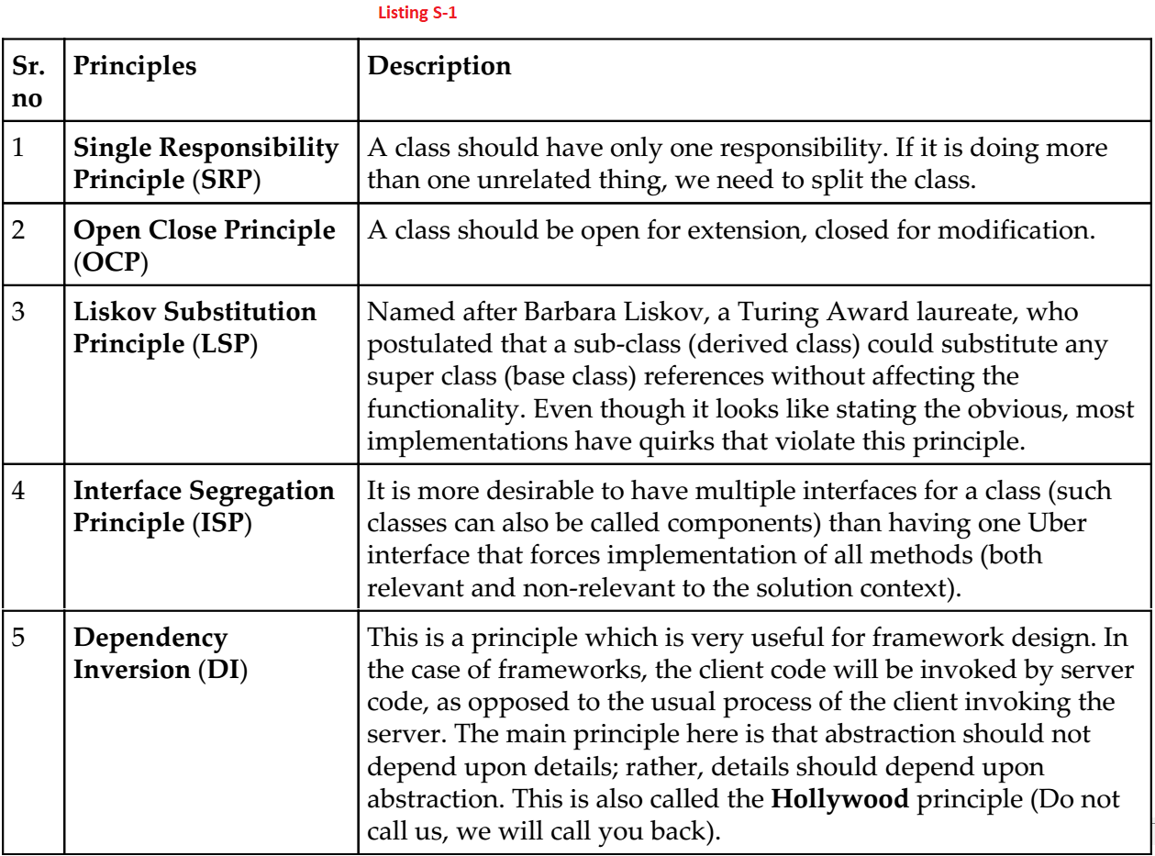
Listing S-1

Slide 37
Why are patterns required?

Slide 38
A quick foray into the .NET Reflection API

Slide 39
Personal income tax computation – A case study

Slide 40
Finalizing the solution

Slide 41
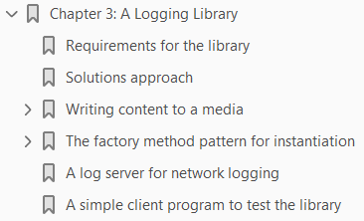
A Logging Library
3

Slide 42

Targeting Multiple Databases
4

Slide 43
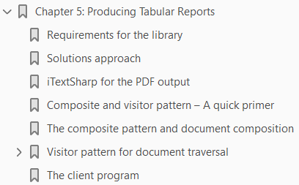
Producing Tabular Reports
5

Slide 44
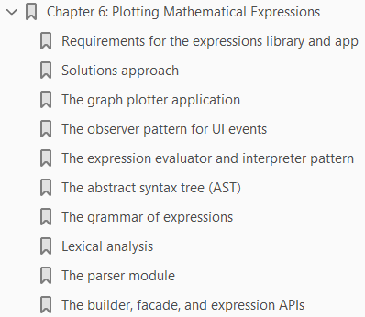
Plotting Mathematical Expressions
6

